Slide 1

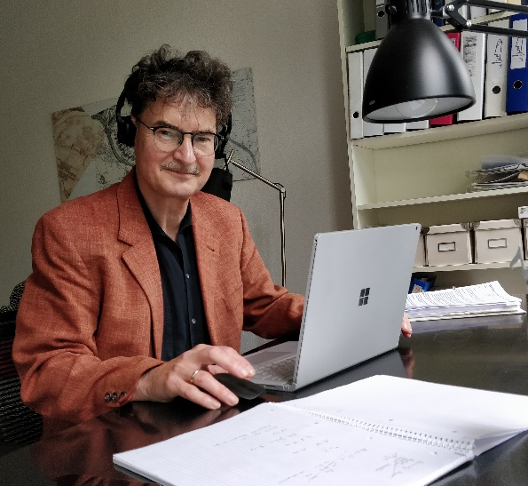

Road Traffic Engineering
Welcome!
This is a recorded presentation! Just switch on your speakers and klick the presentation mode button!
(envfx) fotolia
Prof. Dr.-Ing. Andreas Schuster
Notes:
Welcome!
Introduction AS
CV
Field of work
>

Slide 2
Table of Contents
Introduction
Locality and Responsibility Information
Study Program
Current Information / Questions
Introduction ∙ Locality/Responsibility ∙ Study Program ∙ Current
Notes:
(refer)
Locality and Responsibility Information
Location of university facilities
>

Slide 3
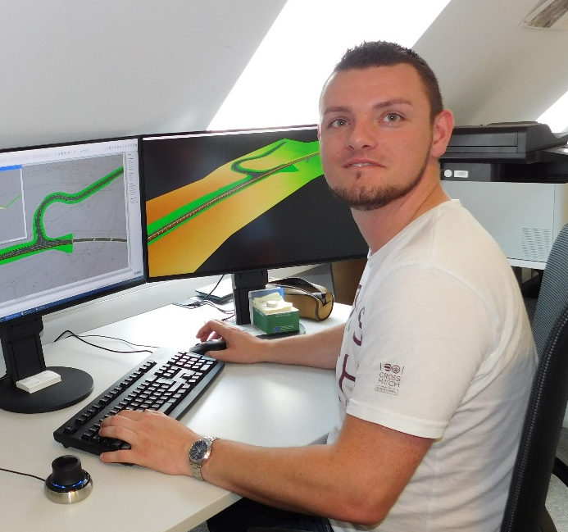
Staff
Dipl.-Ing. (FH) Michael Müller
Executive laboratory engineer and study program advisor
michael.mueller.4@fh-zwickau.de
Introduction ∙ Locality/Responsibility ∙ Study Program ∙ Current
Notes:
(refer)
Locality and Responsibility Information
Location of university facilities
>

Slide 4
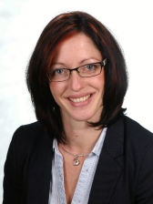
Staff
Stephanie Schmidt
Manager of examination authority and study program advisor
stephanie.schmidt@fh-zwickau.de
room S 2210
Introduction ∙ Locality/Responsibility ∙ Study Program ∙ Current
Notes:
(refer)
Locality and Responsibility Information
Location of university facilities
>

Slide 5
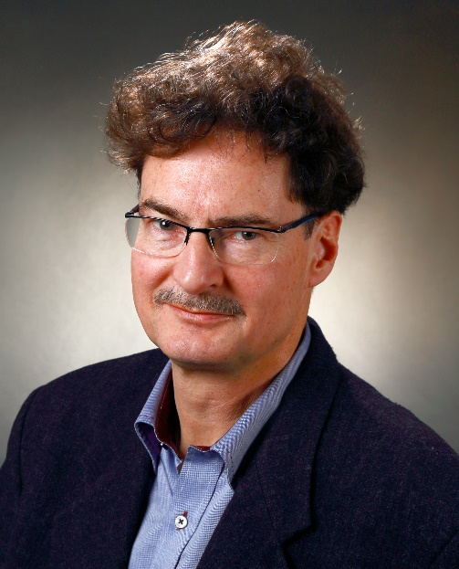
Staff
Prof. Dr.-Ing. Andreas Schuster
Head of institute and of study program committee
andreas.schuster@fh-zwickau.de
Introduction ∙ Locality/Responsibility ∙ Study Program ∙ Current
Notes:
(refer)
Locality and Responsibility Information
Location of university facilities
>

Slide 6
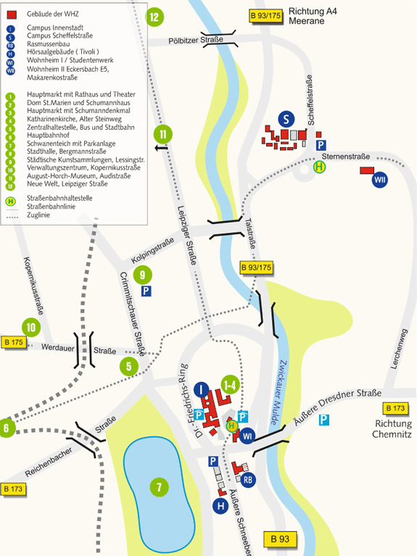
Locality
Introduction ∙ Locality/Responsibility ∙ Study Program ∙ Current
Notes:
(refer)
Locations of RT facilities
>

Slide 7
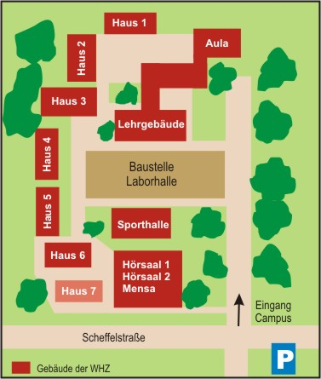
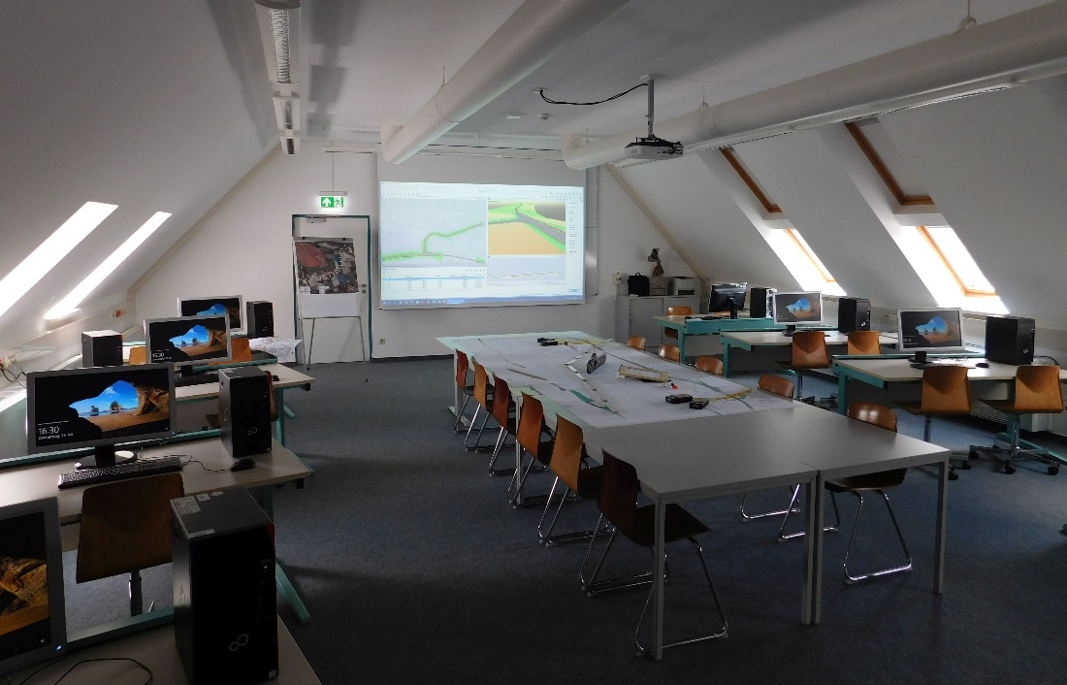
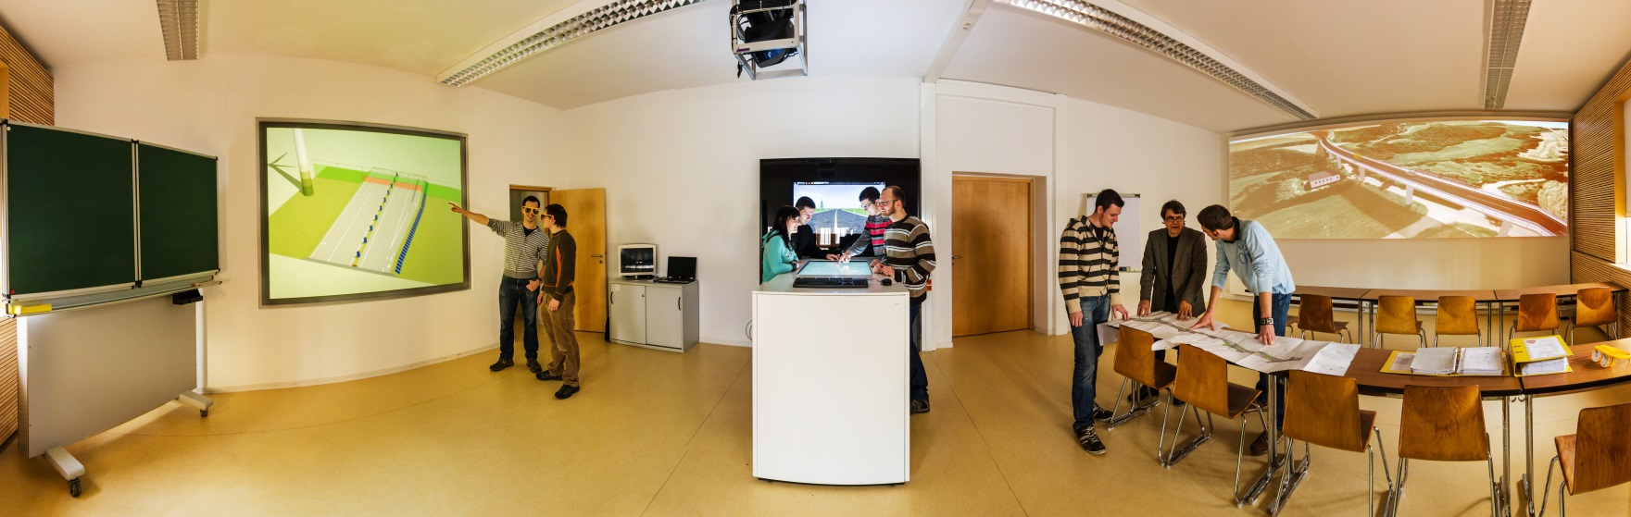
Locality
Traffic engineering laboratory
Visualization laboratory
Design laboratory
Offices
Driving simulation
laboratory
Introduction ∙ Locality/Responsibility ∙ Study Program ∙ Current
Notes:
(refer)
Responsibilities
>

Slide 8
University Structure
Management
…
Students committee
…
Academic institutions
Administration
…
Faculty: Automotive Engineering
    > Study program committe (Prof. Dr. Schuster,
    Dipl.-Ing. (FH) Michael Müller)
    michael.mueller.4@fh-zwickau.de
    > Vice-dean of education (Prof. Dr. Scheffler)
    michael.scheffler@fh-zwickau.de
    > Examination board (Prof. Dr. Nagel)
    lutz.nagel@fh-zwickau.de
    (Stephanie Schmidt)
    stephanie.schmidt@fh-zwickau.de
…
…
Department of study affairs
  > Admissions office (Christina Kirchner)
  christina.kirchner@fh-zwickau.de
  > student secretary (Anke Zenker)
  anke.zenker@fh-zwickau.de
> Career service (Markus Haubold)
markus.haubold@fh-zwickau.de
International Office (Elke Kunze)
elke.kunze@fh-zwickau.de …
…
Central institutions
…
Library
Computer center (ZKI)
Center of sports
…
Introduction ∙ Locality/Responsibility ∙ Study Program ∙ Current
Notes:
(refer; ask, to write names down)
Study Program
Structure
>

Slide 9
Curriculum
1
Obligatory Courses
Elective Courses
2
Obligatory Courses
Elective Courses
3
Praxismodul
Elective Courses
-
4
Austauschsemester
Master Project
Diplomprojekt
Introduction ∙ Locality/Responsibility ∙ Study Program ∙ Current
Notes:
System of courses and examinations examinations
>

Slide 10
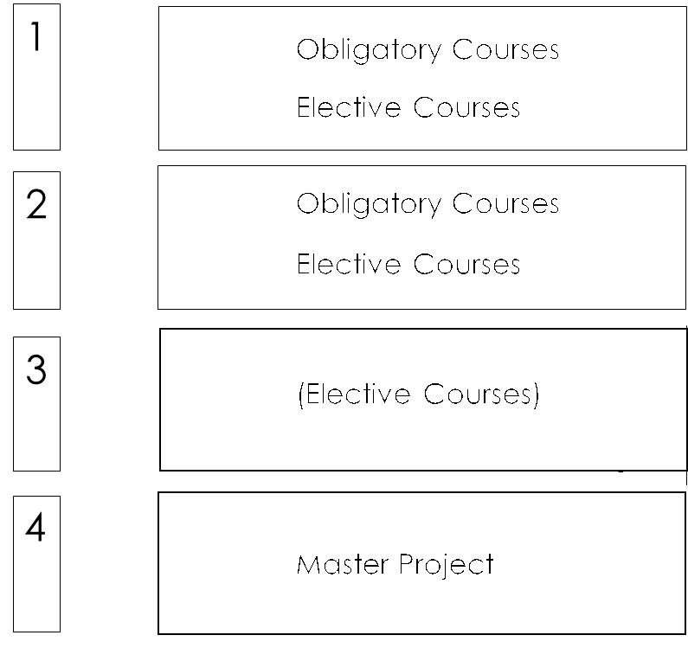
Courses and Examinations
  Information about all
  permitted RT courses:
  modulux.fh-zwickau.de
  Information about all
  offered courses
  (lecture timetable):
  mobile.fh-zwickau.de/vlv/vlv.php
  Selecting elective courses:
  email to
  stephanie.schmidt@fh-zwickau.de
  Deadline: end of 2nd semester week
Introduction ∙ Locality/Responsibility ∙ Study Program ∙ Current
Notes:
Kinds of courses: obligatory courses (all in your timetable)
elective courses (some in your timetable)
Semester workload +/- 30 ECTS-P
Information about all permitted RT courses: modulux.fh-zwickau.de
>
(demonstrate)
Selection of elective courses
- Select permittet RT courses in Modulux
- Check in lecture timetable, if courses are offered in the current semester
>
Apply for selected courses until … by writing an email to …
>
Recommendation: select German courses!
>
Your timetable
>

Slide 11
Courses
1st Semester
Obligatory course
Recommended
elective course
Introduction ∙ Locality/Responsibility ∙ Study Program ∙ Current
Notes:
- Obligatory courses
- Recommended elective courses
Remark: Even these elective courses has to been applied for!
Current Information
>

Slide 12
Courses
1st Semester
Obligatory course
Recommended
elective course
Introduction ∙ Locality/Responsibility ∙ Study Program ∙ Current
Notes:
- Obligatory courses
- Recommended elective courses
Remark: Even these elective courses has to been applied for!
Current Information
>

Slide 13
Courses
1st Semester
Obligatory course
Recommended
elective course
Introduction ∙ Locality/Responsibility ∙ Study Program ∙ Current
Notes:
- Obligatory courses
- Recommended elective courses
Remark: Even these elective courses has to been applied for!
Current Information
>

Slide 14

Current Information
  Access to moodle:
  https://whz-moodle-02.zw.fh-zwickau.de/moodle/login/index.php
  Log in („Anmelden“)
  Go to start page („Startseite“)
  Click „show more“ („ Mehr anzeigen“)
  Go to the directory of the Faculty of Automotive Engineering („Fakultät KFT“)
  Select „KFT07070 Dimensioning and Assessing …“
German language elective courses:
https://www.fh-zwickau.de/studium/studierende/studienorganisation/studierendenangelegenheiten/stundenplaene/stundenplan/?matrikel=Deutschkurs
Mail to stephanie.schmidt@fh-zwickau.de and valentina.knorr@fh-zwickau.de
commons.wikimedia.org
Introduction ∙ Locality/Responsibility ∙ Study Program ∙ Current
Notes:
(refer)
Questions
>

Slide 15
Current Information
  Access to moodle:
  https://whz-moodle-02.zw.fh-zwickau.de/moodle/login/index.php
  Log in („Anmelden“)
  Go to start page („Startseite“)
  Click „show more“ („ Mehr anzeigen“)
  Go to the directory of the Faculty of Automotive Engineering („Fakultät KFT“)
  Select „KFT07070 Dimensioning and Assessing …“
German language elective courses:
https://www.fh-zwickau.de/studium/studierende/studienorganisation/studierendenangelegenheiten/stundenplaene/stundenplan/?matrikel=Deutschkurs
Mail to stephanie.schmidt@fh-zwickau.de and valentina.knorr@fh-zwickau.de
commons.wikimedia.org
Introduction ∙ Locality/Responsibility ∙ Study Program ∙ Current
Notes:
(refer)
Questions
>

Slide 16
Questions?
! ? !
Introduction ∙ Locality/Responsibility ∙ Study Program ∙ Current

Slide 17
Goodbye!
Thank you for your attention!
See you in the first recorded presentation of my lecture!

